Slide 1


Employee Management System
This presentation outlines an employee management web application built with Java full stack and MySQL. The application provides functionalities for adding, viewing, editing, and deleting employee details, streamlining the management process for organizations.

Slide 2

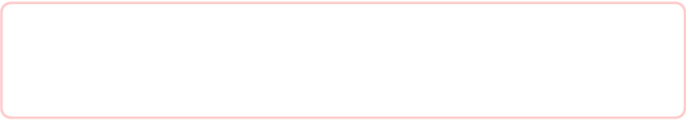
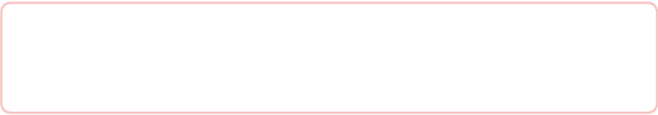
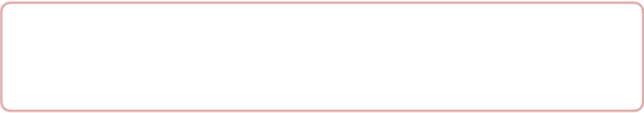
Employee Management System Overview
Streamlined Management
The employee management system simplifies handling records.
Dynamic Data Handling
Allows users to manage employee information efficiently.
Robust Technology Stack
Utilizes Java and MySQL for robust backend and database.

Slide 3



Challenges of Existing Employee Record Systems
Lack of Integration
2
Difficult to access or modify employee details efficiently.
Manual Processes
Time-consuming and prone to errors.
1
Common Issues
3
Data redundancy, loss of information, and tracking difficulties.

Slide 4




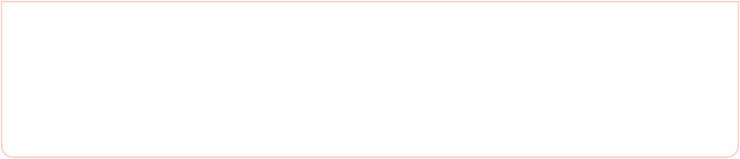

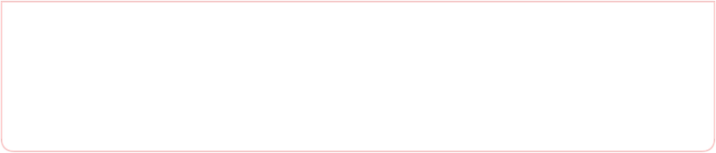

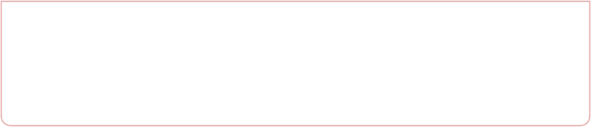
Proposed Employee Management System
1
Web Application
Allows efficient management of employee records.
2
User Accessibility
Access through web browsers for flexibility.
3
Modern Technologies
Built with user-friendly modern web technologies.

Slide 5



Advantages of the Web Application
This web application offers several significant benefits that improve usability and operational efficiency within organizations. By simplifying navigation and centralizing data, it enhances productivity and user satisfaction.
User-Friendly Interface
Improved Efficiency
Data Centralization
Designed to be intuitive, allowing users to navigate easily.
Automated processes minimize time spent on managing employee details.
All employee information is stored in a single database, reducing redundancy.

Slide 6
Application Disadvantages
Initial Setup Time
Setting up the application and database may require some time and technical expertise, which could delay initial implementation.
Dependency on Internet
2
The application requires a reliable internet connection to access the web application, which can be a limitation in areas with poor connectivity.
1
Data Security Risks
3
Storing sensitive employee information online necessitates robust security measures to prevent unauthorized access.

Slide 7




Hardware Requirements
To effectively host the application and its database, specific hardware requirements must be met, including server specifications, client device capabilities, and network quality.
Server
Client Devices
Network
A dedicated server with a minimum of 8 GB RAM and 500 GB storage to host the application and database effectively.
Any device capable of running a modern web browser (desktop, laptop, tablet).
Reliable internet connectivity with sufficient bandwidth to ensure smooth operation of the web application.

Slide 8





Software Requirements
Operating System
Java Development Kit (JDK)
Linux or Windows Server for hosting the application and database.
Version 8 or later for developing the Java application.
MySQL
Web Server
Version 5.7 or later for managing the employee database.
Apache Tomcat or similar for deploying the web application.

Slide 9




Employee Management Module
Edit Employee Records
View Employee Details
Delete Employee Records
Add Employees
2
3
1
4

Slide 10
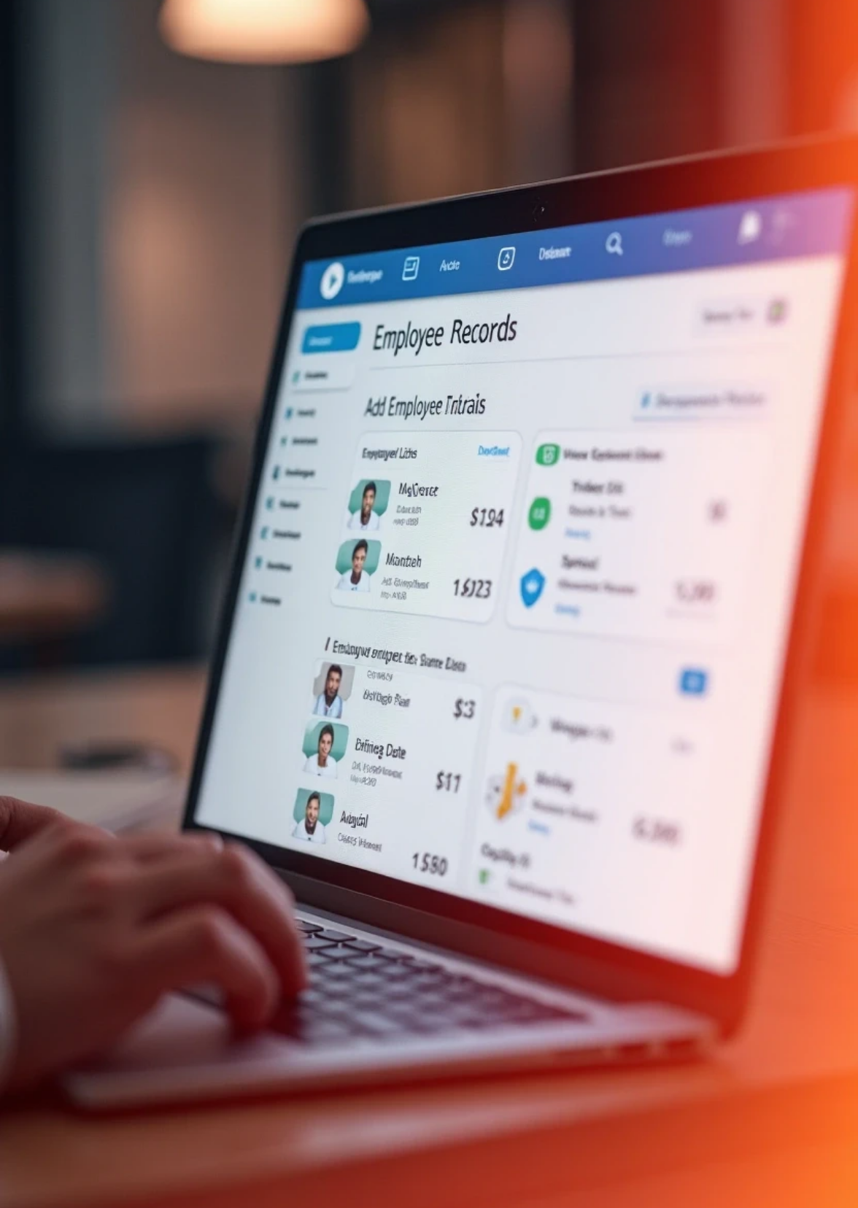
Employee Management Module Overview
Add Employee Records
Update Existing Data
View Employee Lists
Delete Records

Slide 11
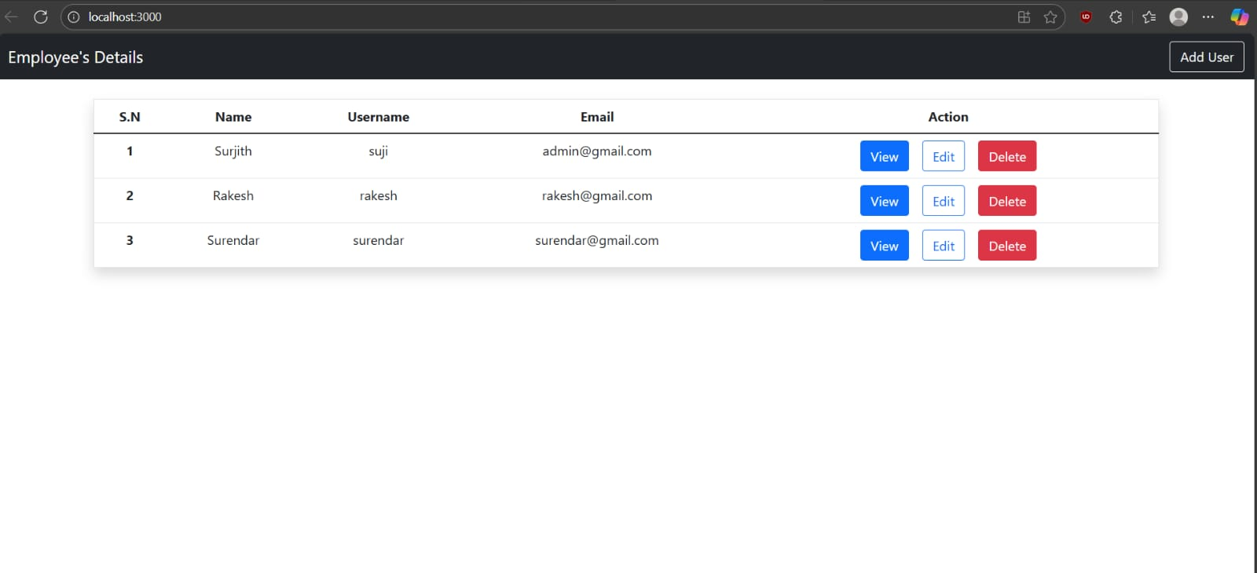
SAMPLE OUTPUT:
.

Slide 12
CONCLUSION:
The employee management web application provides a comprehensive solution for managing employee records efficiently. By embracing modern web technologies, it enhances productivity and simplifies administrative tasks.

